Slide 1
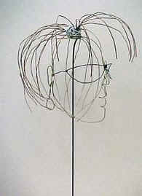
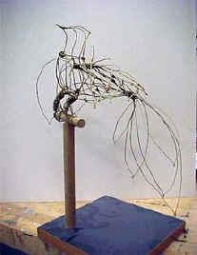
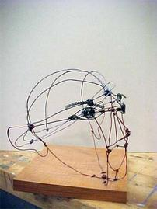
Wire Sculpture
Wire is a mobile inkline. Instead of drawing with a pen, you draw with the wire itself.
There are no rules whatsoever, no right way to create with wire.

Slide 2
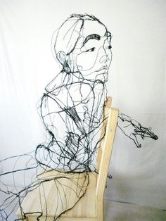
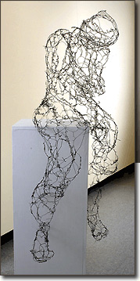
Naomi Grossman

Slide 3
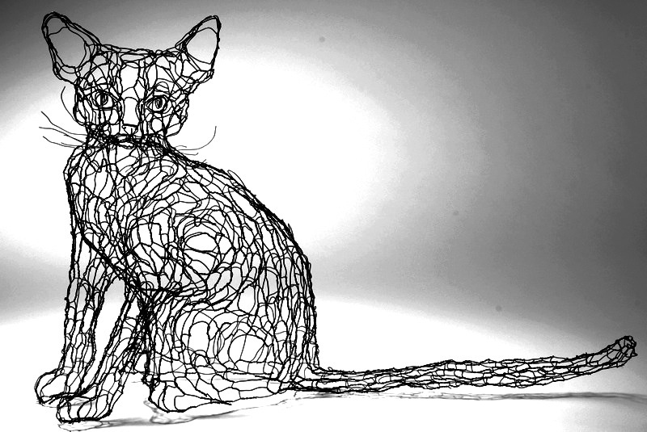
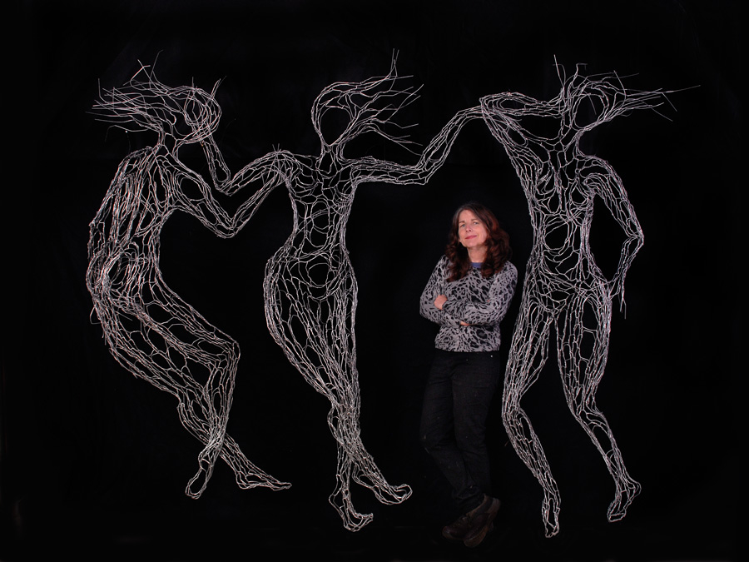
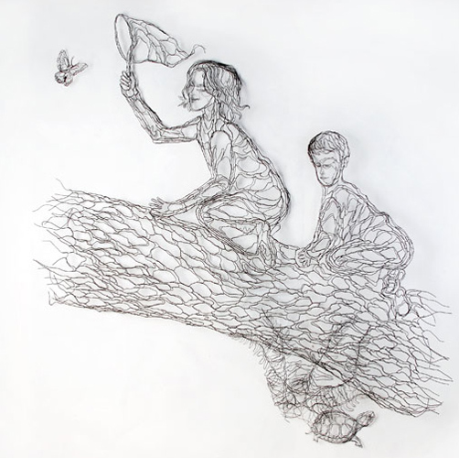
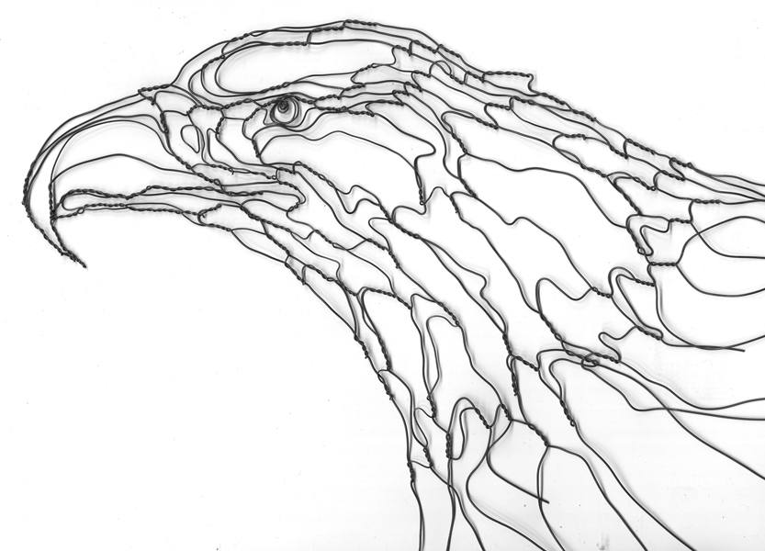
Elizabeth Berrien

Slide 4
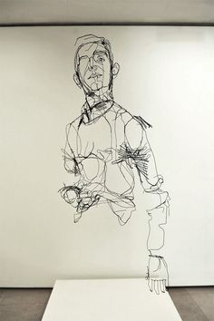
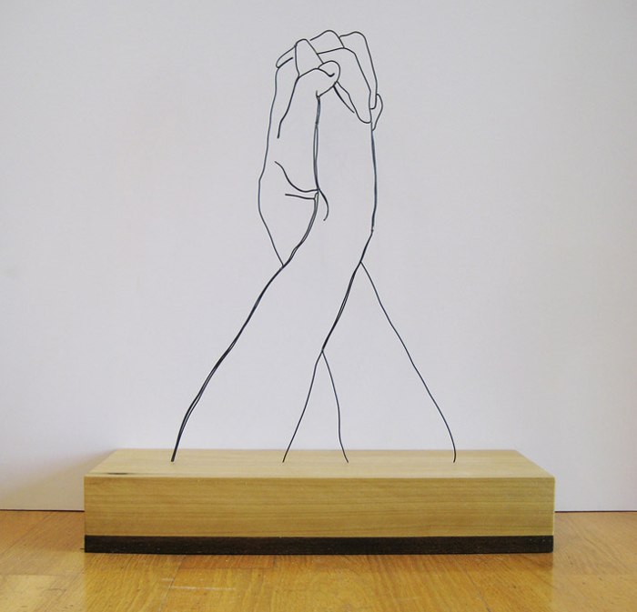

Slide 5
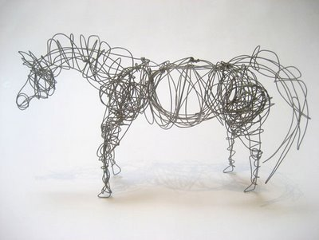
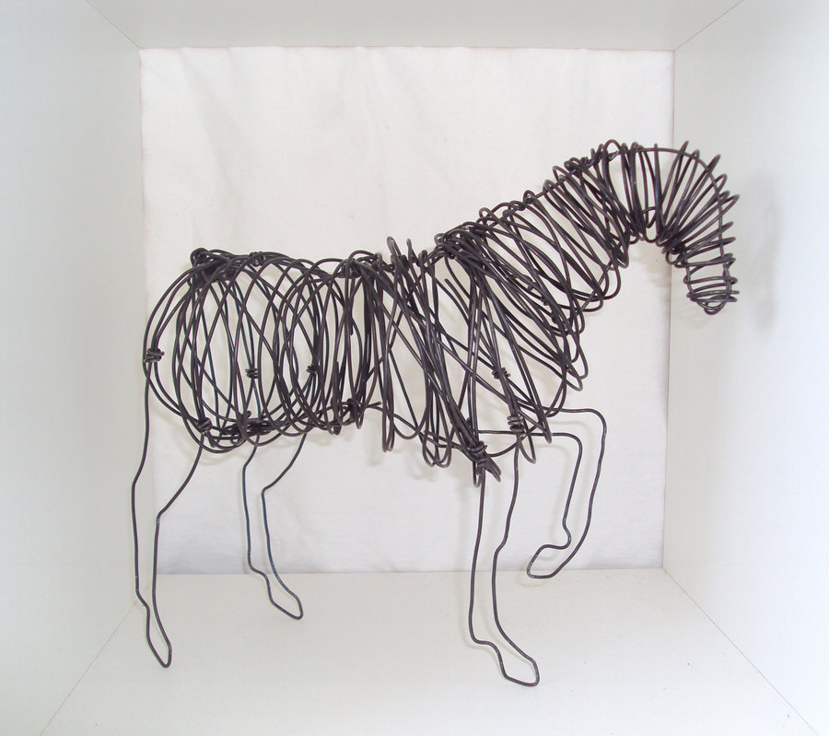

Slide 6
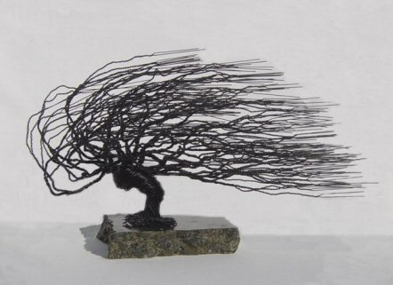
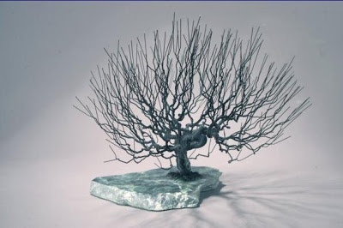

Slide 7
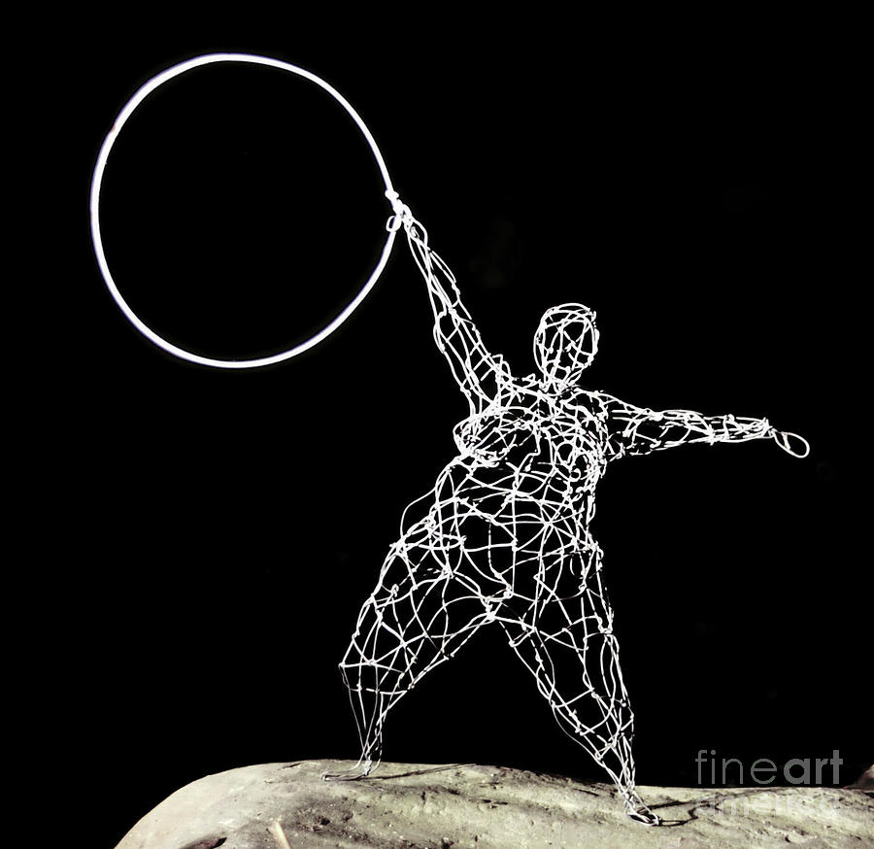
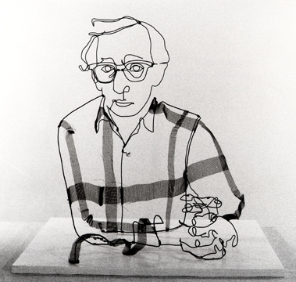

Slide 8
Three Wire Exercise
How many different things can you do with just 3 wires?
Think about objects you enjoy looking at, think of a few important aspects of that object and try to get them down in wire
How many different ways can you attach the wire to itself? How strong or weak are the results?
What happens when you combine 2 or more different thicknesses of wire?
Can kinked wire be straightened again? Does it have to be?

Slide 9
Two major Elements in Wire Sculpture
Design: the form and impact of the wire sculpture
Structure: the degree to which the sculpture holds together

Slide 10
Subject Matter
Figure: a depiction of the human body
Figure/Object at rest
Figure/Object in motion
Bust: a sculpture of a person's head, shoulders, and chest

Slide 11
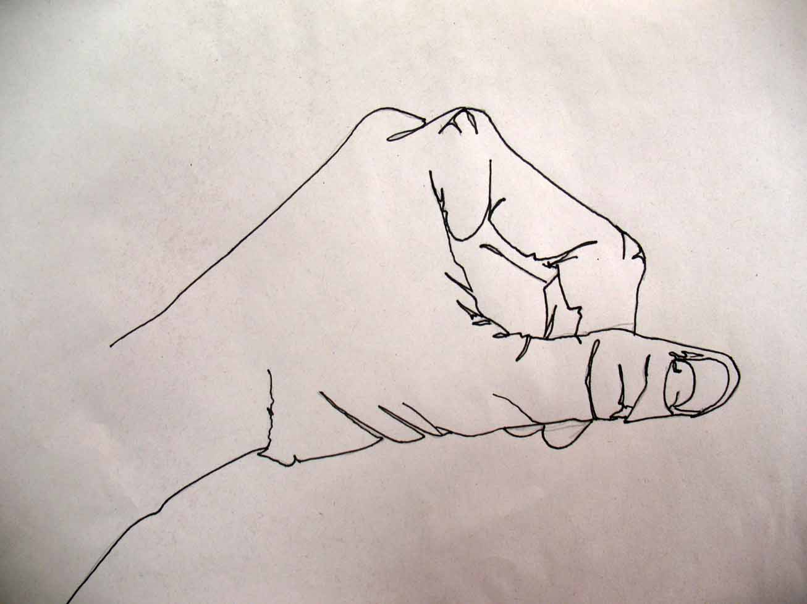
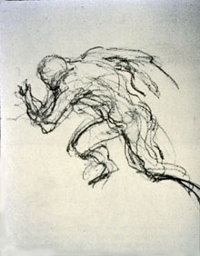
Types of Lines
Outline: a drawing or picture that shows only the shape of an object
Contour Line: slow and controlled line that focuses on the edges of an object
Gesture Line: quick, energetic and catch the movements and gestures of an active figure

Slide 12
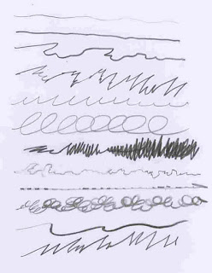
Expressive Lines
Using line to portray a certain feeling or emotion
Less concern with naturalism

Slide 13
Additional Vocabulary
Shape: An enclosed space having only two-dimensions
Can be geometric or organic
Form: Three-dimensional and encloses volume
Wire gauge: a measurement of how large a wire is, the higher the number, the thinner the wire

Slide 14
Alexander Calder
https://www.youtube.com/watch?v=ovC9_LDnK1o

Slide 15
Wire Sculpture Criteria
Use of line
Did you make good use of line by wrapping wire continuously with no shapes dangling and the sculpture is an integrated whole
Did you create line with wire, moving from area to area in a fluid manner?
Did you accurately represent the proportion of the object?
Did you successfully create a form that occupies space in the round?
Problem solving
Technical skills
Risk-taking
Craftsmanship
Effort
Time on task

